Slide 1
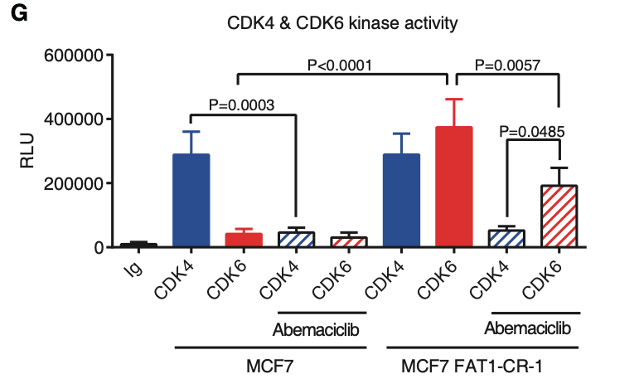
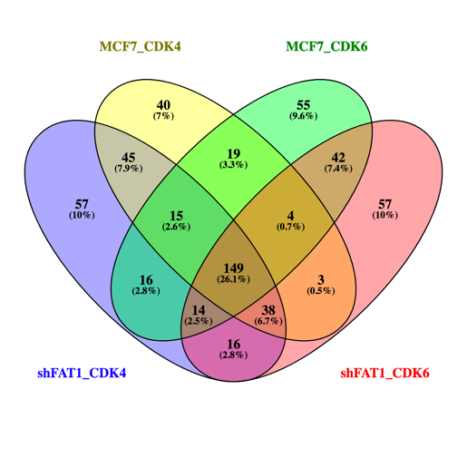
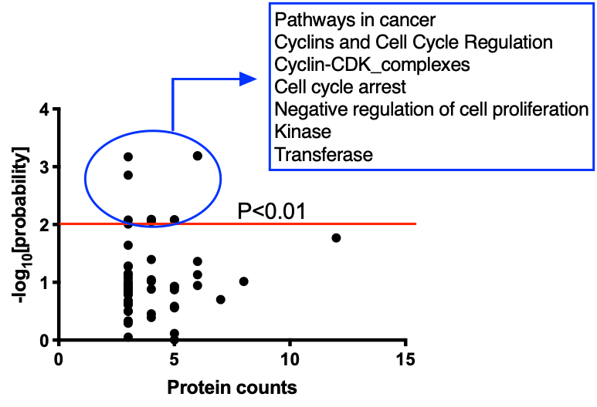
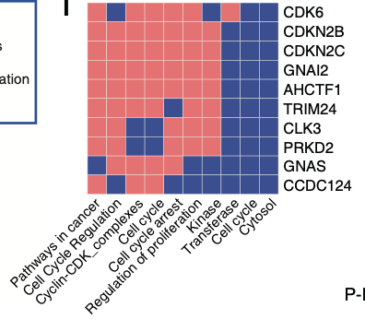
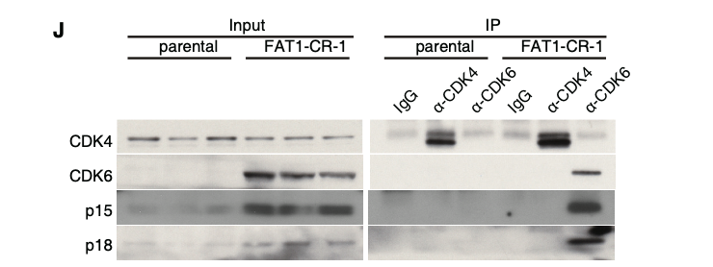
Figure 1
Qing:Combine data with only CDK4 vs. CDK6, find overlap
Repeat with another model
Show ranking of the proteins find a better way to explain
Ramya: Another cell line, IP kinase assay, PTEN or CDK6 over expression?
A
B
C
D
E

Slide 2
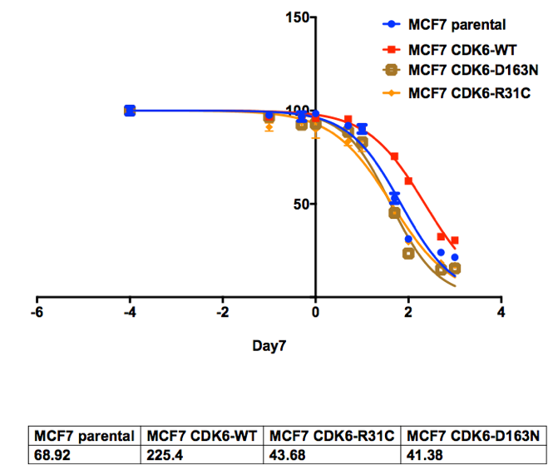
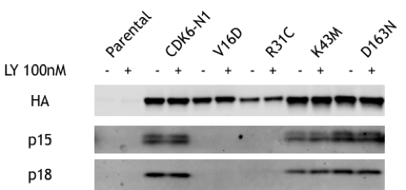
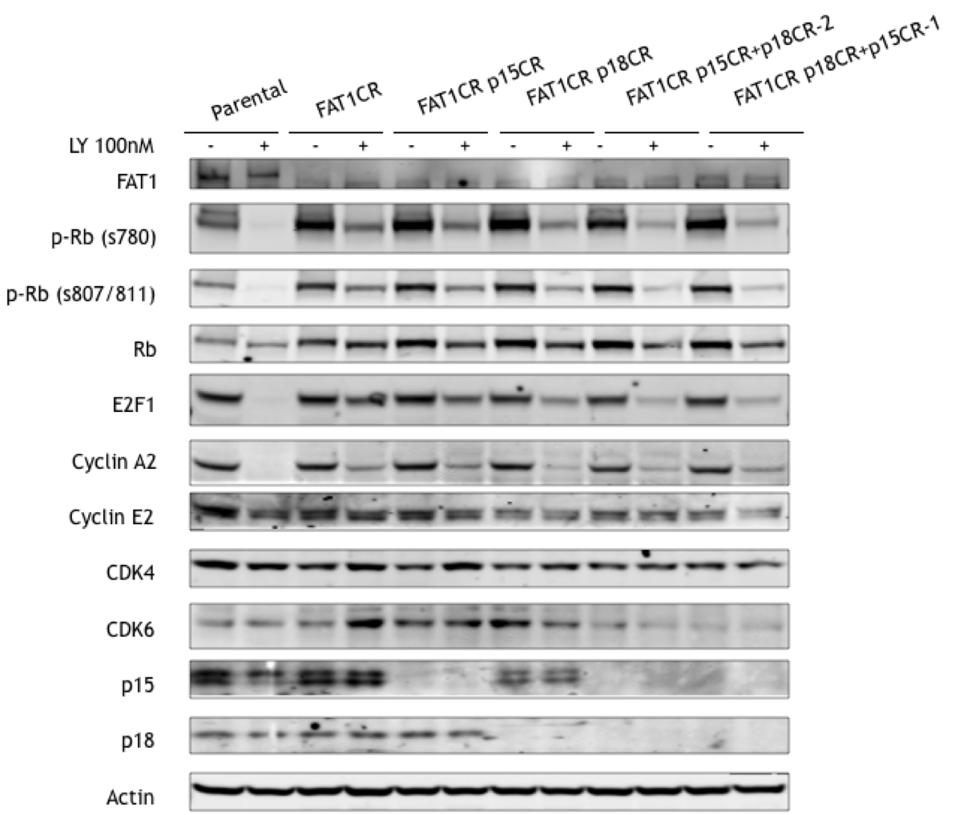
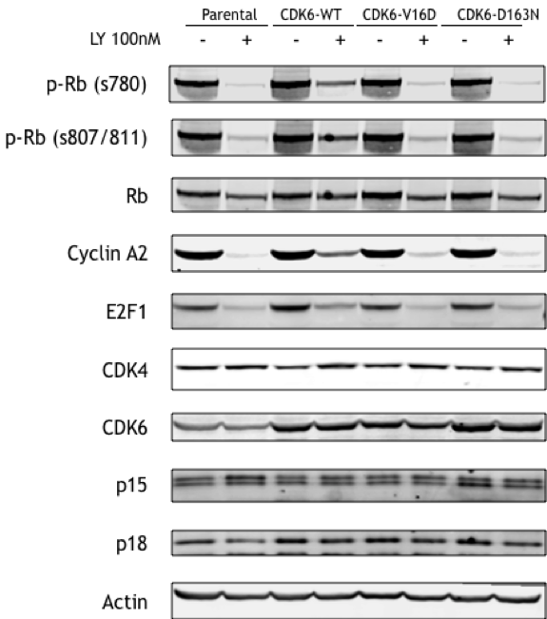
Figure 2
A
INK4 subtype | PDB code | key residue (2.7Å from INK4)
4a (p16) | 1BI8 | V16, K26, K29, R31
4b (p15) | -
4c (p18) | 1G3N | V16, E18, K29, R31, S155,
4d (p19) | 1BLX | E14, E18
C
CDK6-
D
B
Ramya: IP kinase assay
Qing: xo-44 labeling assay

Slide 3
INK4 subtype | PDB code | key residue (2.7Å from INK4)
INK4A (p16) | 1BI8 | V16, K26, K29, R31
INK4B (p15) | -
INK4C (p18) | 1G3N | V16, E18, K29, R31, S155,
INK4D (p19) | 1BLX | E14, E18

Slide 4
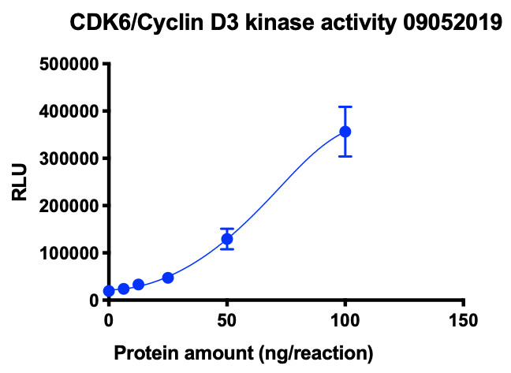
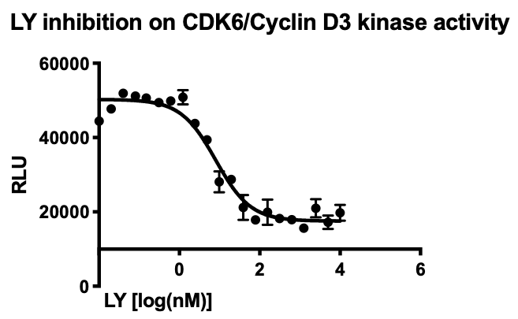
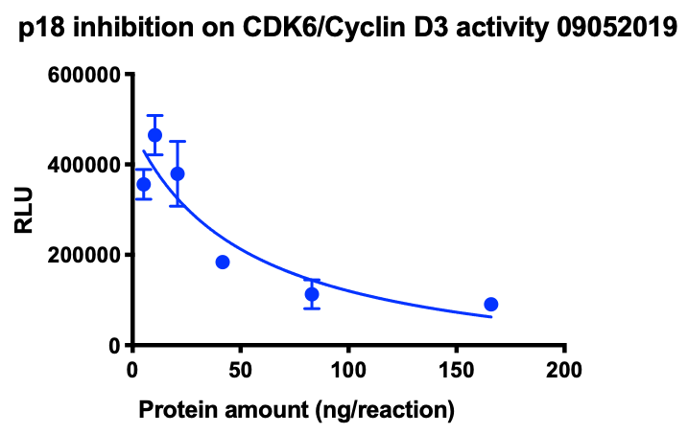
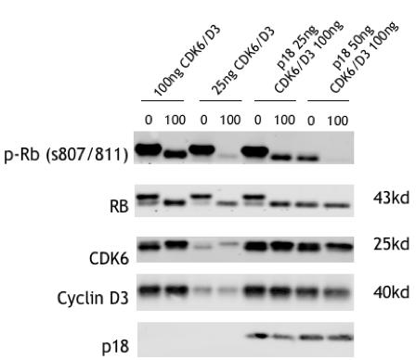
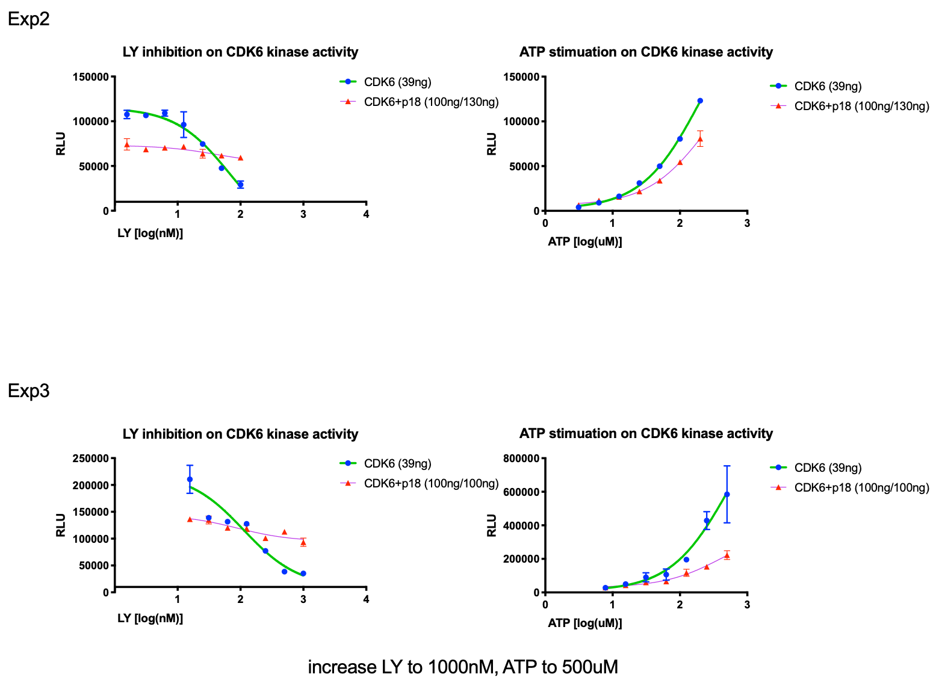
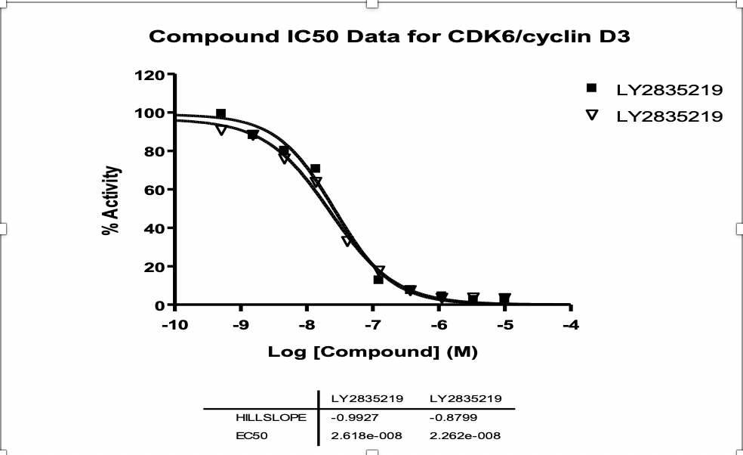
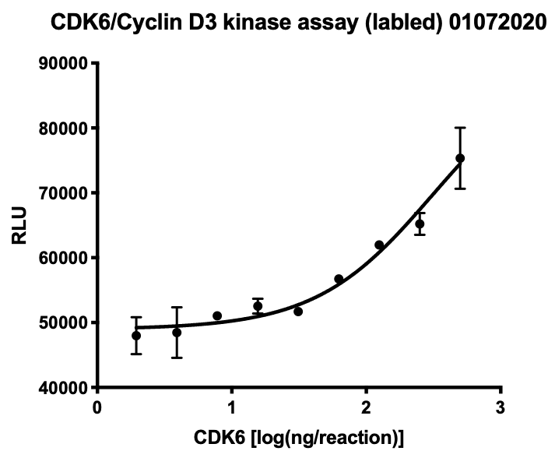
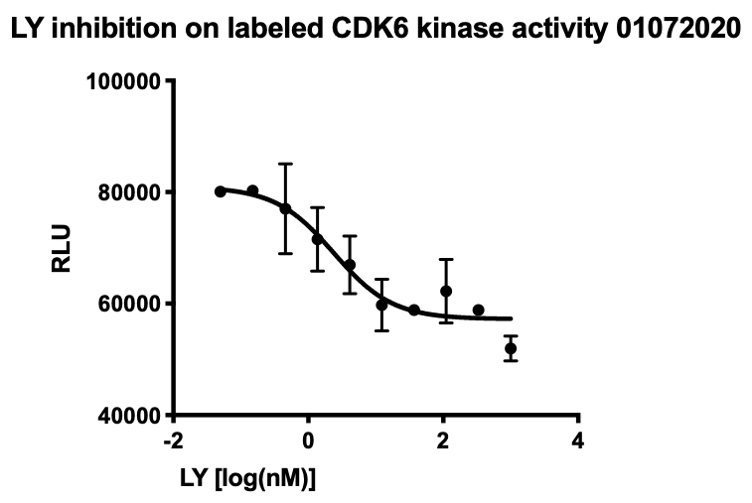
Figure 3
A
B
C
D
E
F
Qing: More drugs, palbo and ribo
IC50=2.385nM
Qing and core: MST assay to show p18 increased Kd

Slide 5
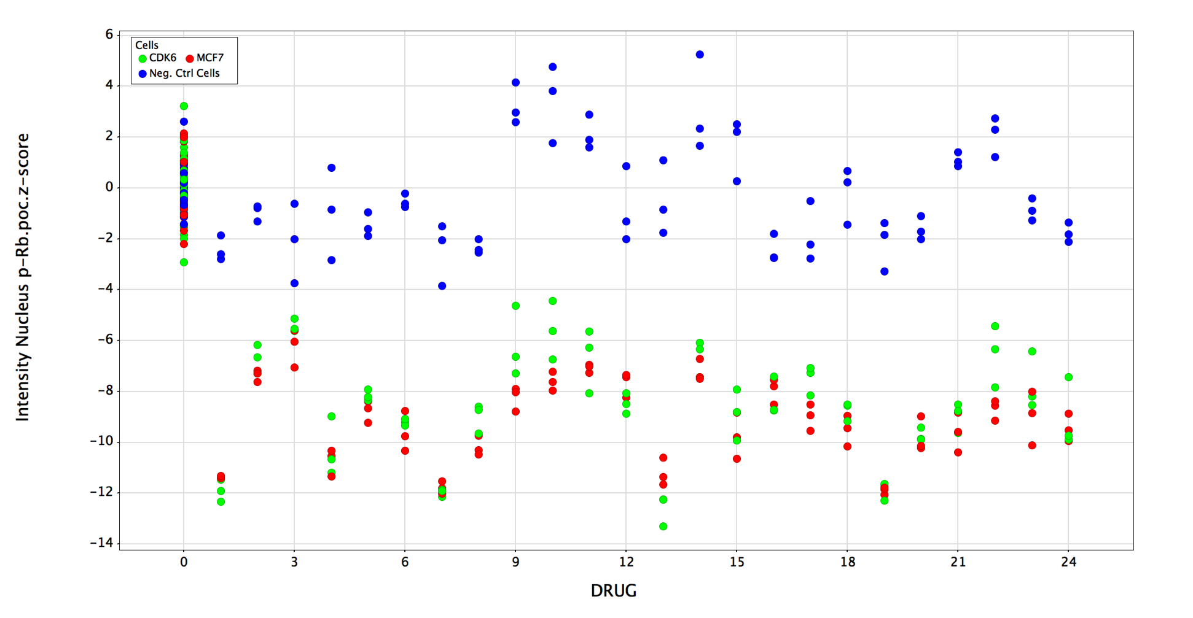
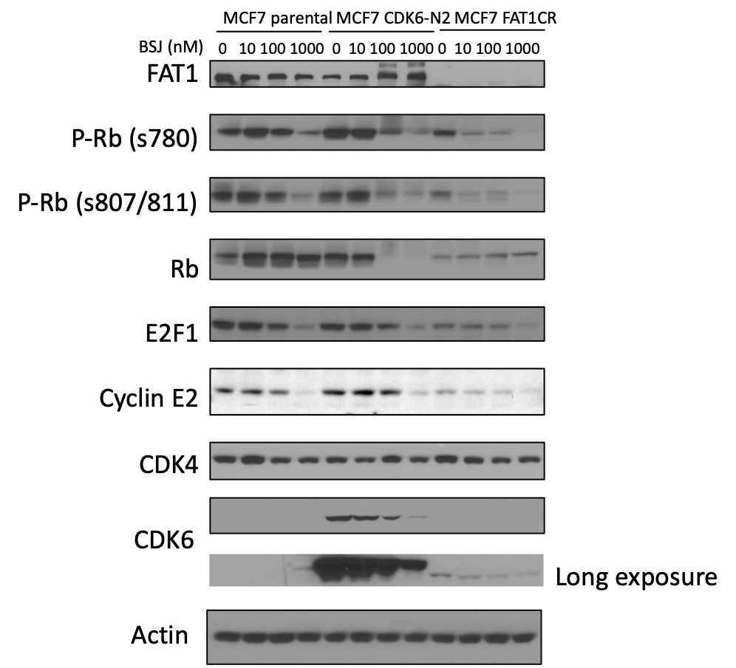
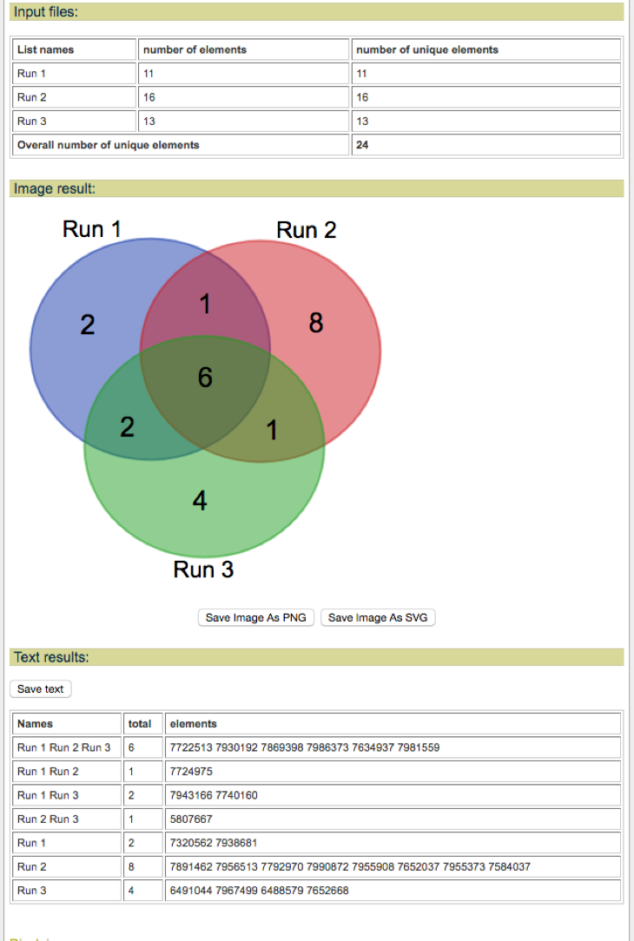
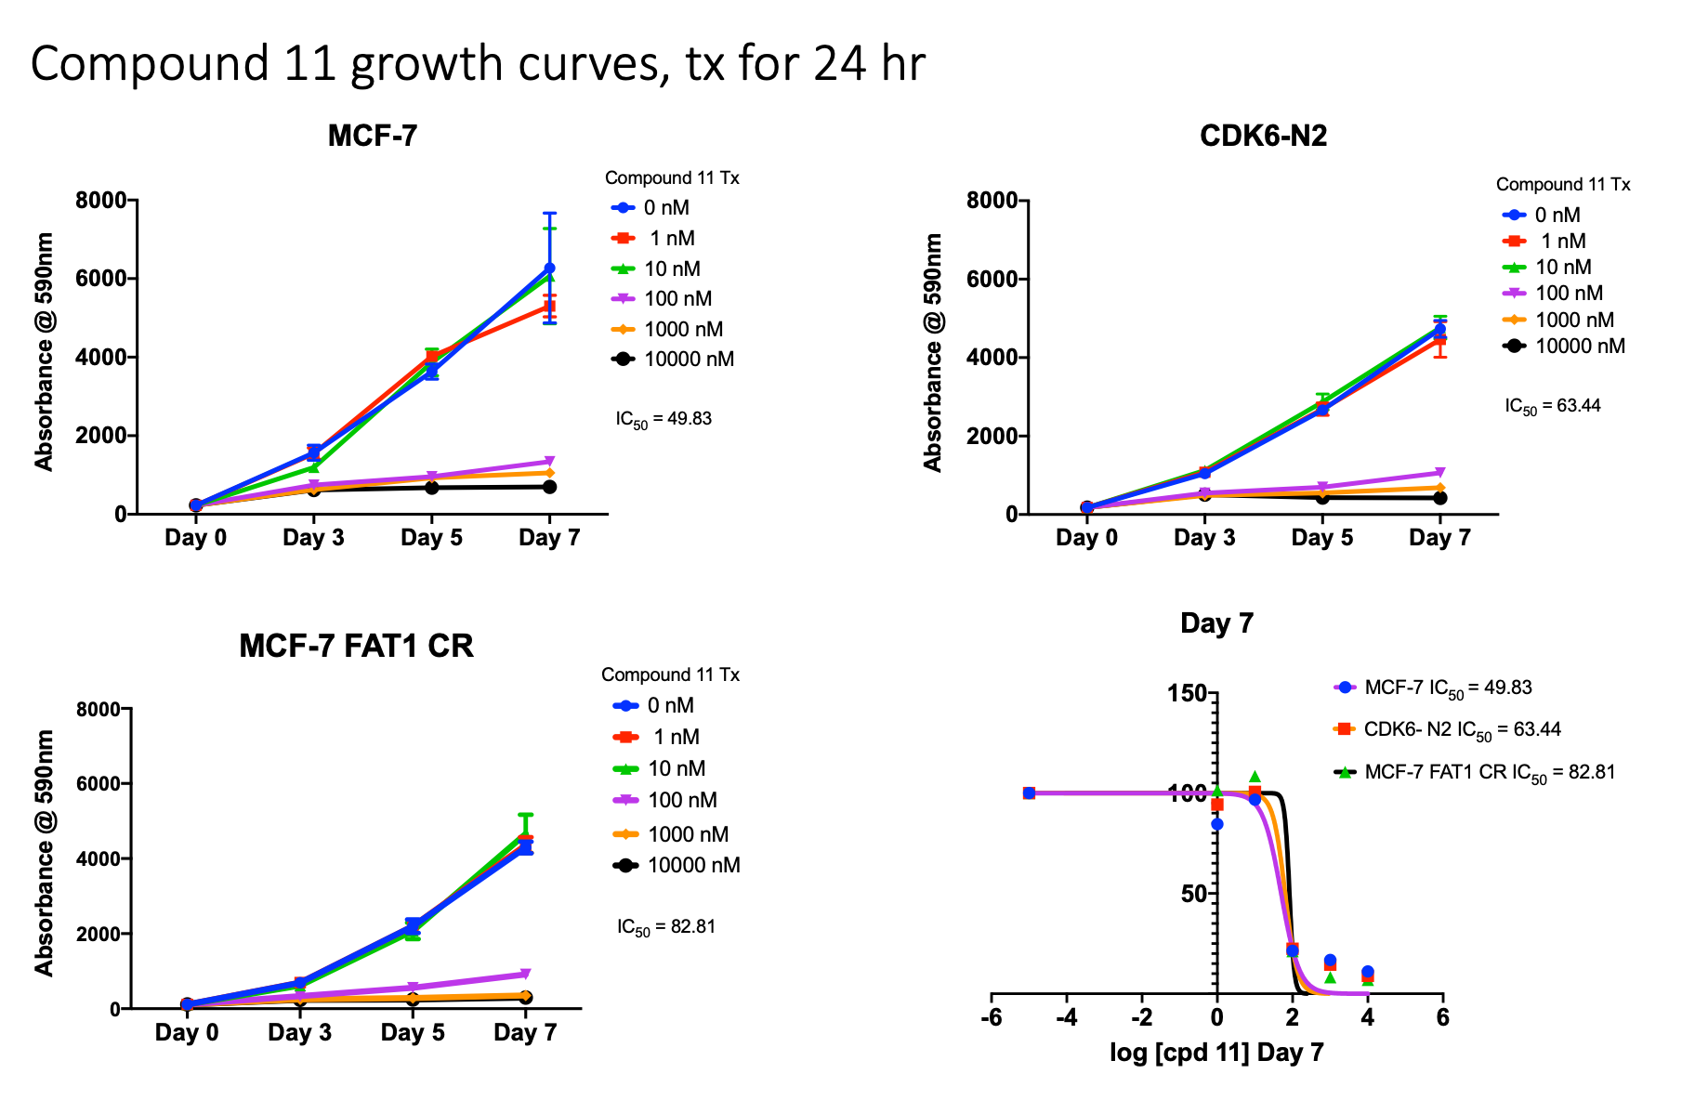
Figure 4
Sarat: Get more drug, do combination with CDK4/6i,
Isabella: Growth curve
Core: In vivo xenograft
Qing: MST with BSJ drug
Qing: Kinase assay (IP and recombinant proteins)
A
C
B
D
Isabella: Compound 11 from screening
Dose-response, combination GC
RB negative model

Slide 6
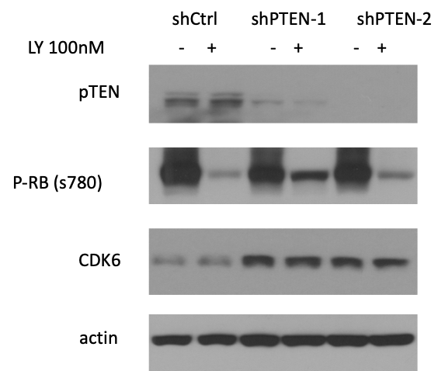
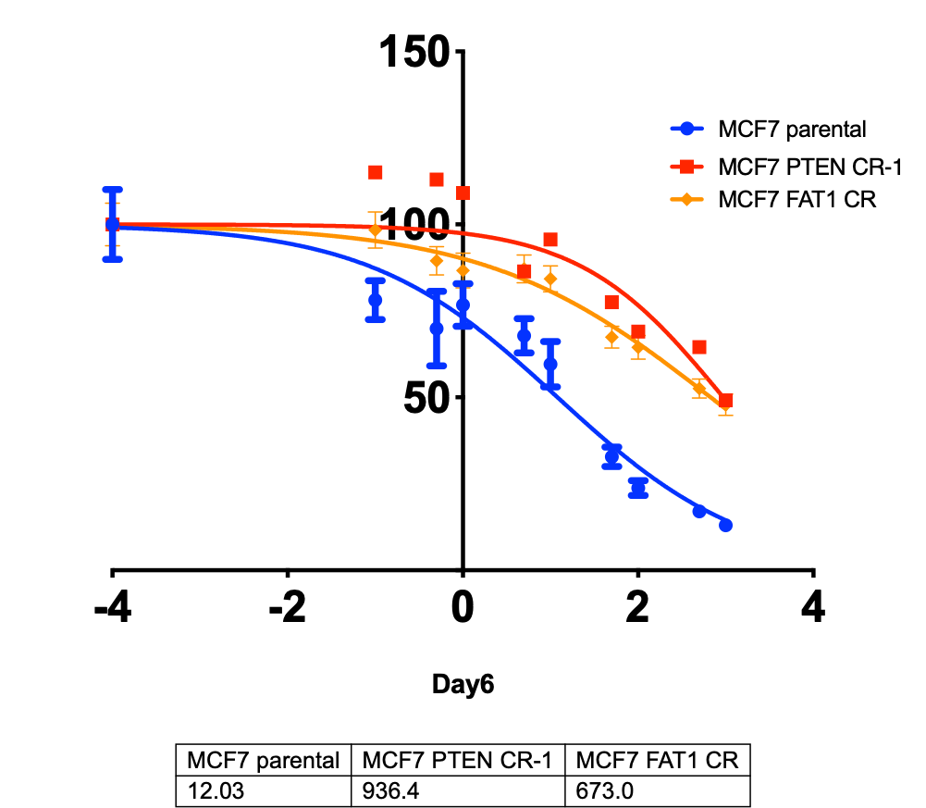
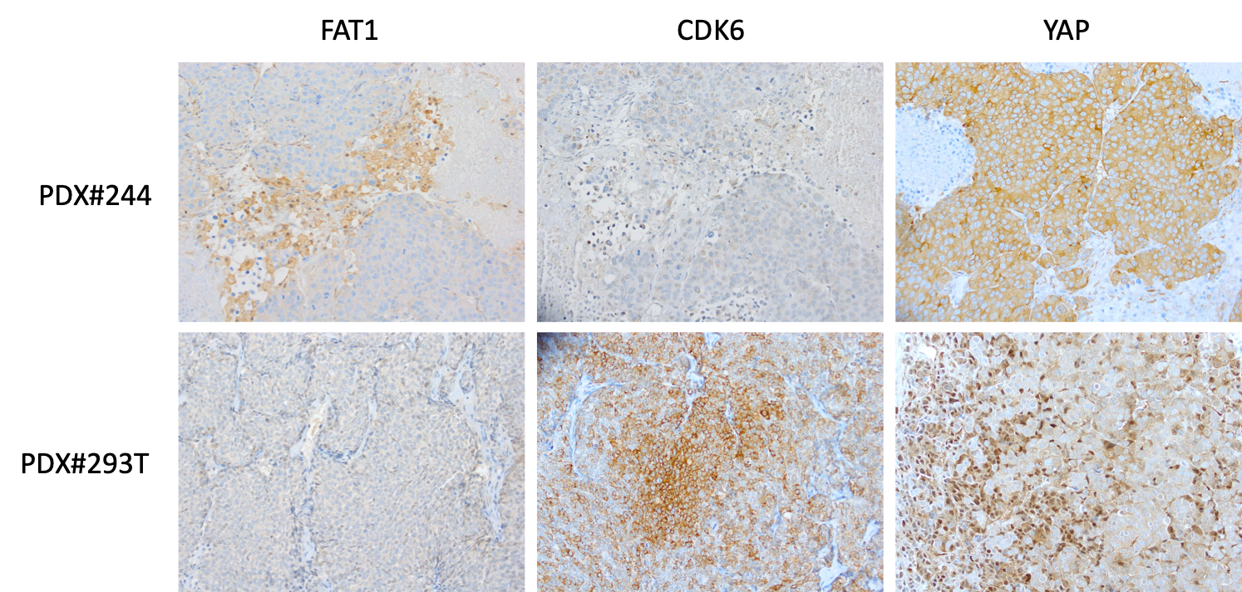
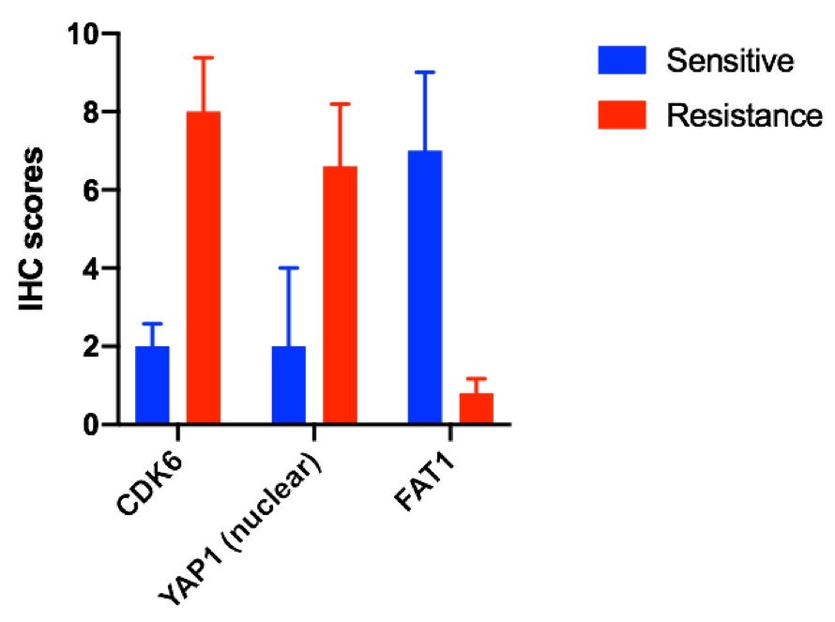
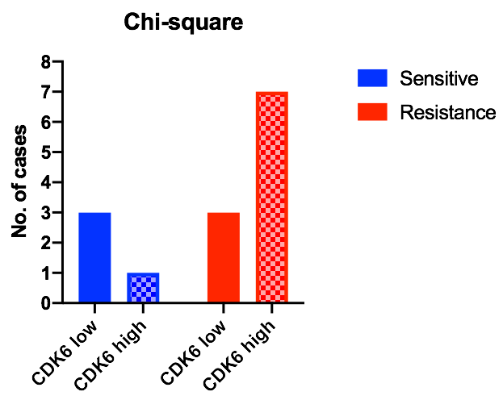
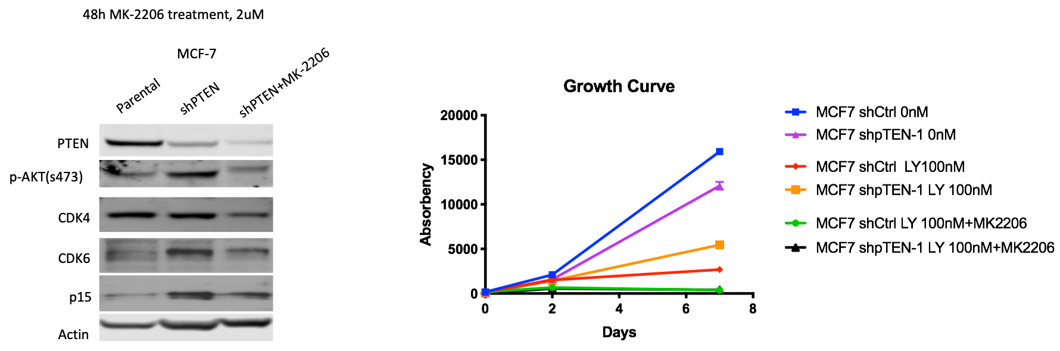
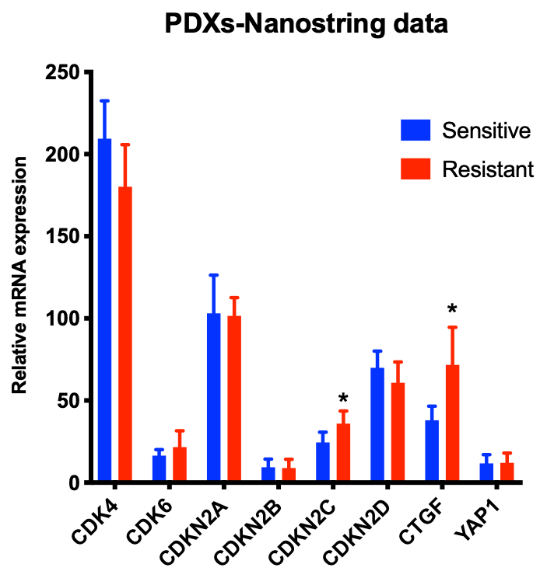
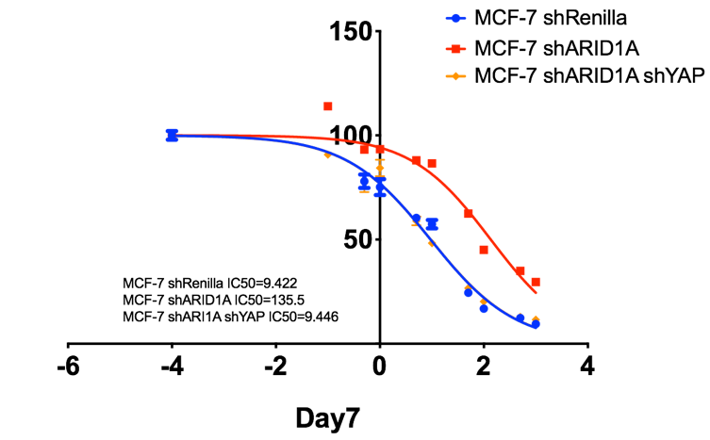
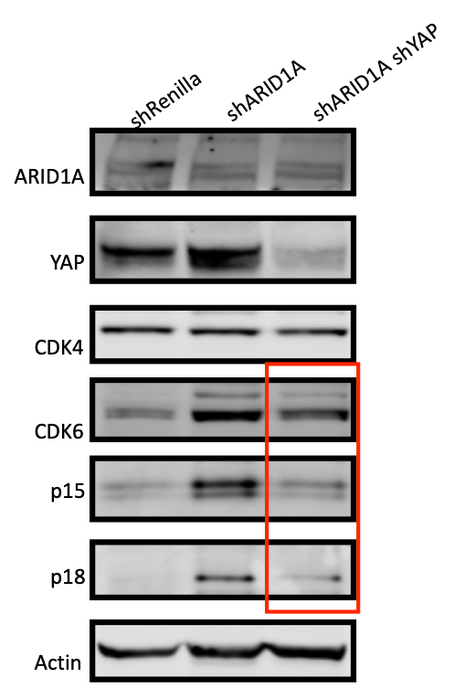
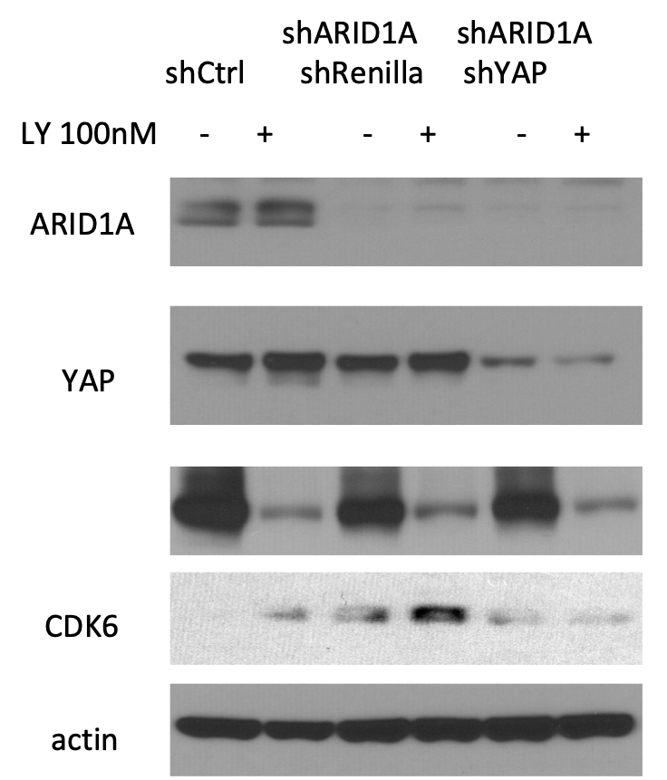
Figure 5
A
B
G
H
C
I
J
F
D
E
Isabella: CDK6, p15 and p18 up regulation in multiple models, FAT1, PTEN, ARID1A loss and CDK6 OE WB
Ramya: co-IP CDK6 in PTEN and ARID1A cell lines
Qing: p15 and p18 overexpression in resistant PDXs
Sarat: Regrow PDXs and do co-IP

Slide 7
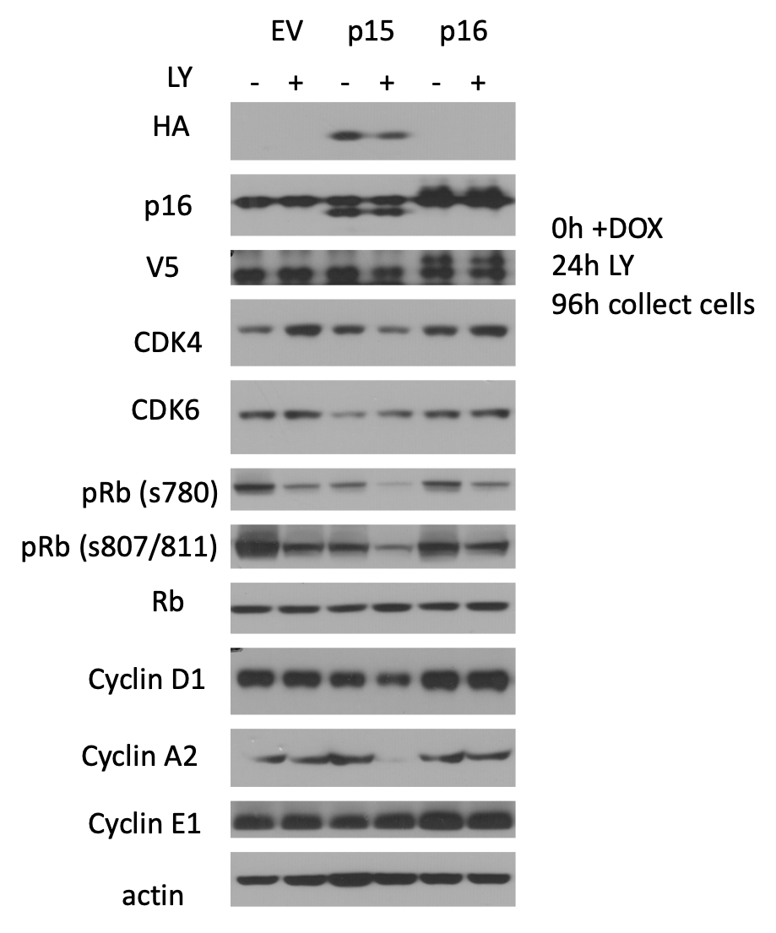
Supplementary 1
Ramya: Dose dependent DOX
Decrease Dox dose and redo the experiment

Slide 8
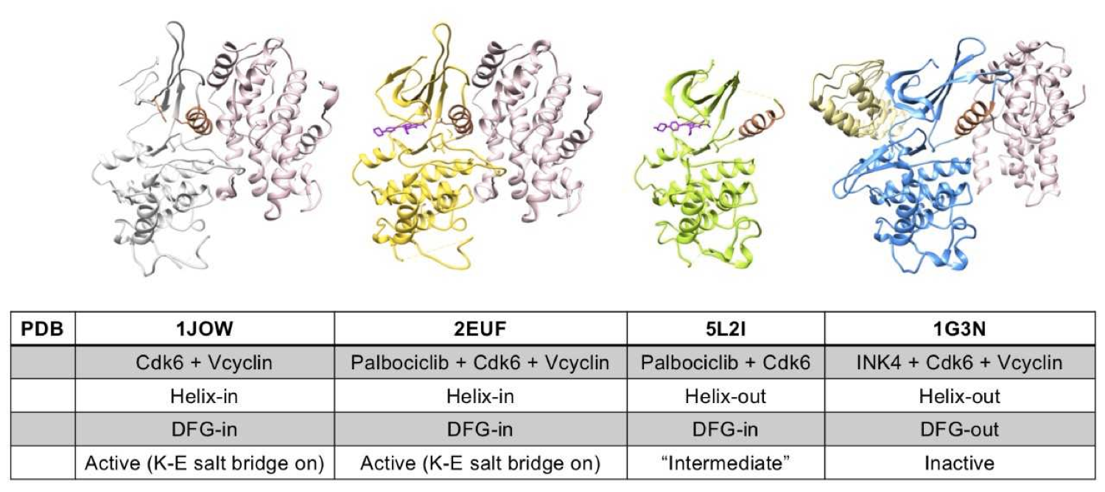
Supplementary 2
Binding sites PROTAC? (Chodera lab)

Slide 9
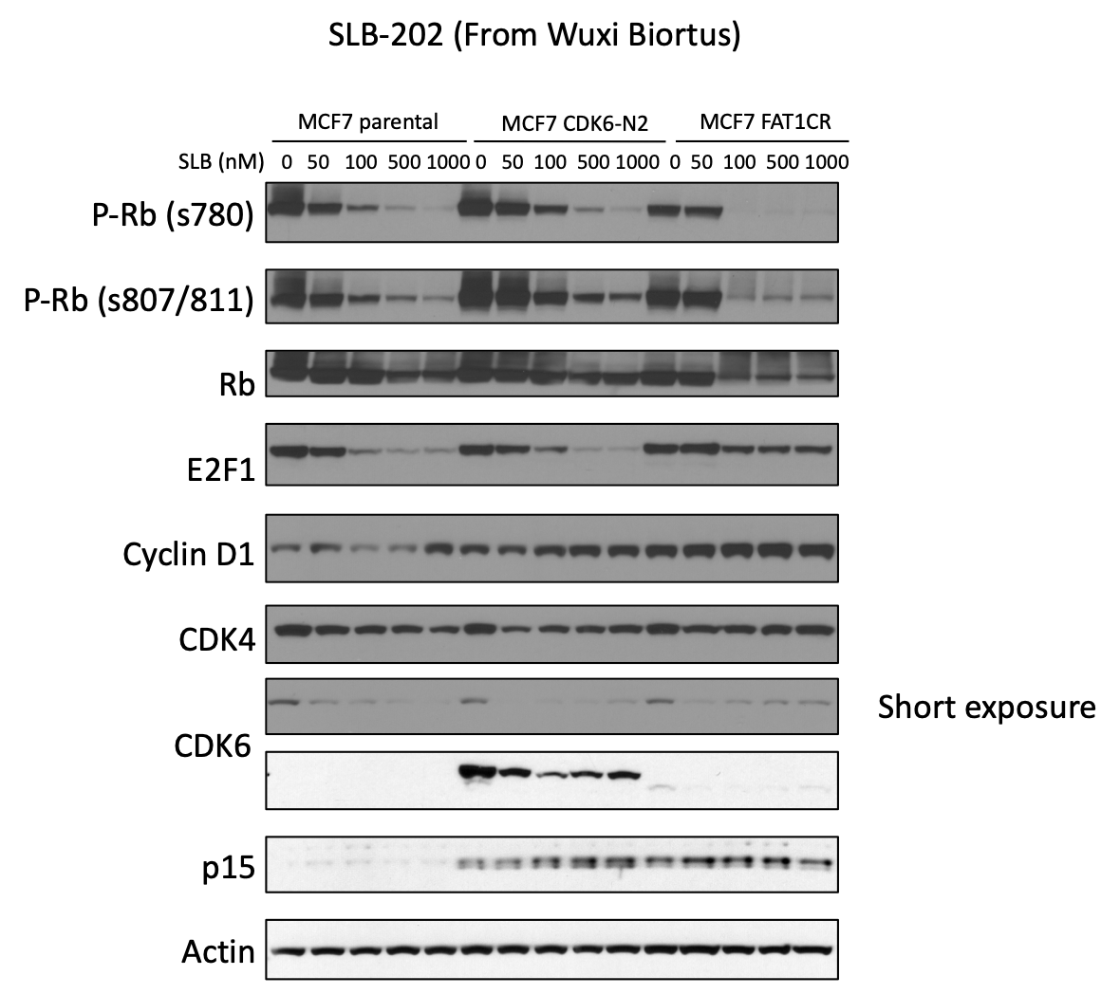
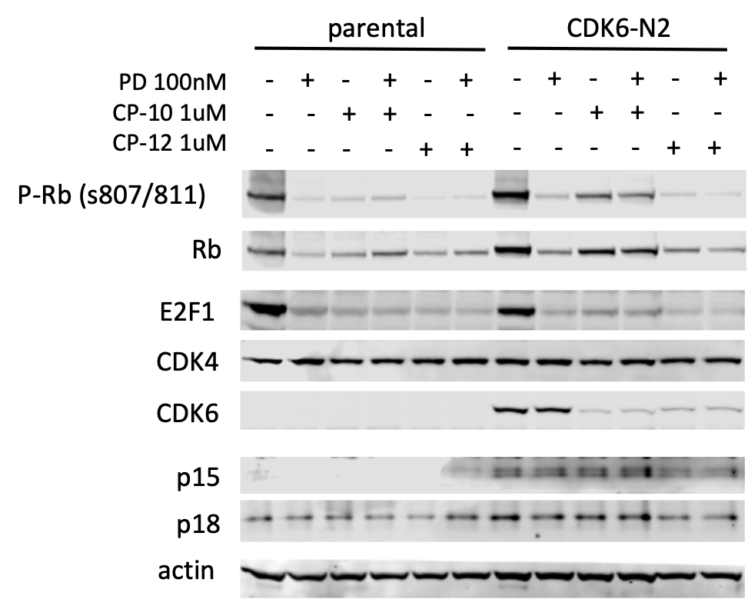
Supplementary 3

Slide 11
Kinase activity
IP-HA

Slide 12
Kinase activity
IP-HA

Slide 13
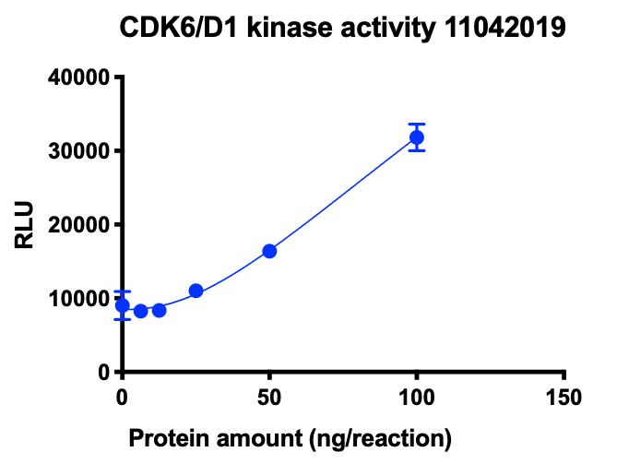
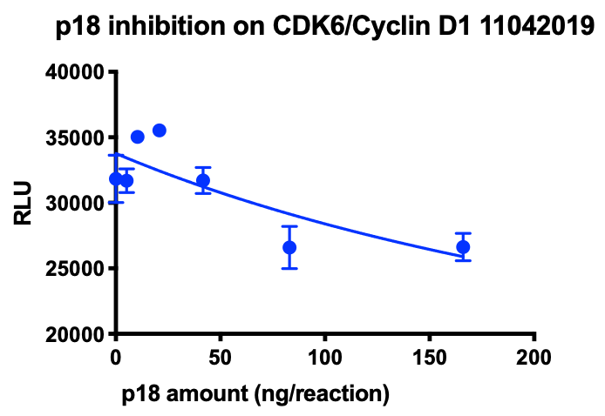
p18INK4C also blocks CDK6/cyclin D1 activity

Slide 14
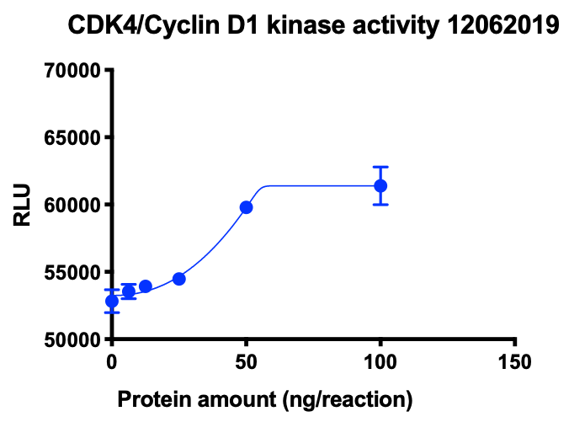
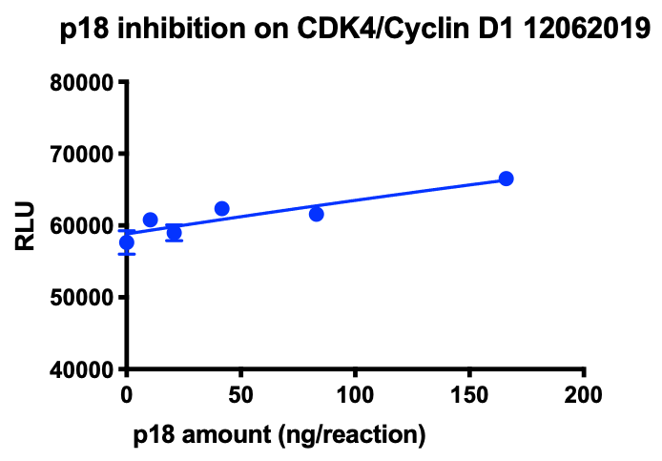
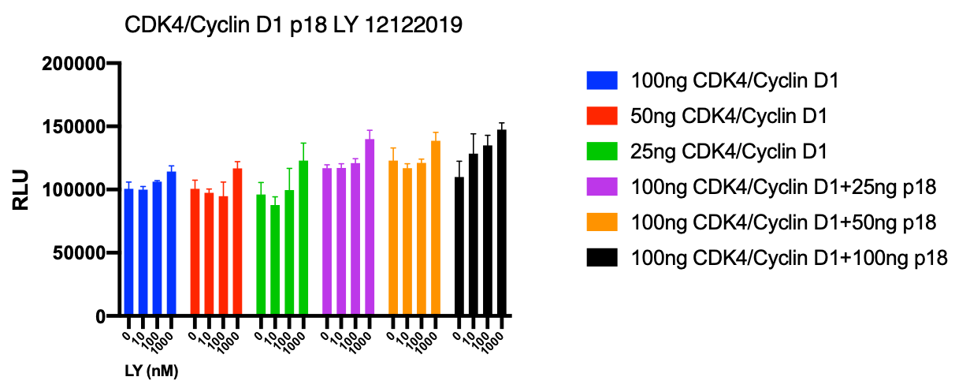
p18INK4C does not block CDK4/Cyclin D1 activity
No LY inhibition

Slide 15
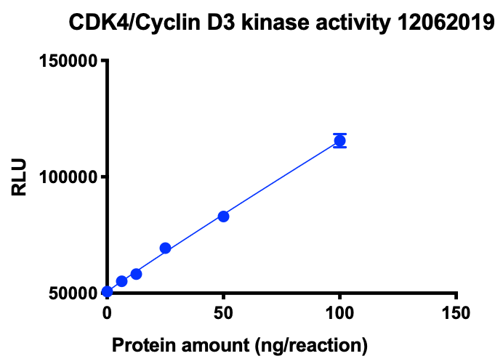
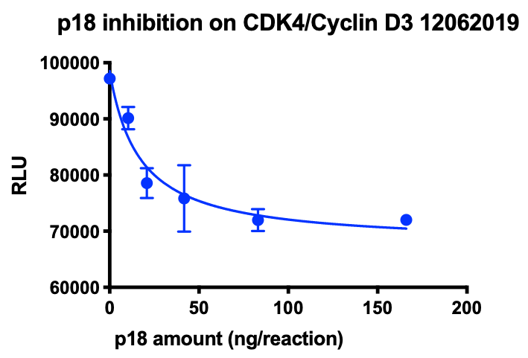
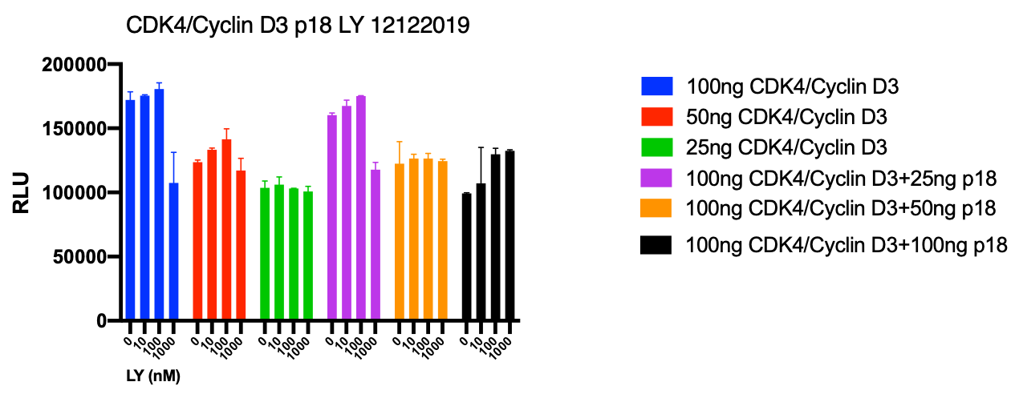
p18INK4C blocks CDK4/Cyclin D3 activity, but not LY inhibition

